Slide 1

EE150 Signals and Systems
Tutorial 1
Xiaopeng Yu (余肖鹏）
Shanghaitech University
March 2024
Tutorial 1
EE 150
March 2024

Slide 2
Outline
Outline
0. Introduction
1. Definition of signals.
2. The operation on signals.
3. Basic signals
Tutorial 1
EE 150
March 2024

Slide 3
01
Definition and properity of signals
0. Introduction
Tutorial 1
EE 150
March 2024

Slide 4
01
Definition and properity of signals
Signals and Systems Abstraction
Describe a system (physical, mathematical, or computational) by the way it transforms an input signal into an output signal.
Input Signal
System
Output Signal
Tutorial 1
EE 150
March 2024

Slide 5
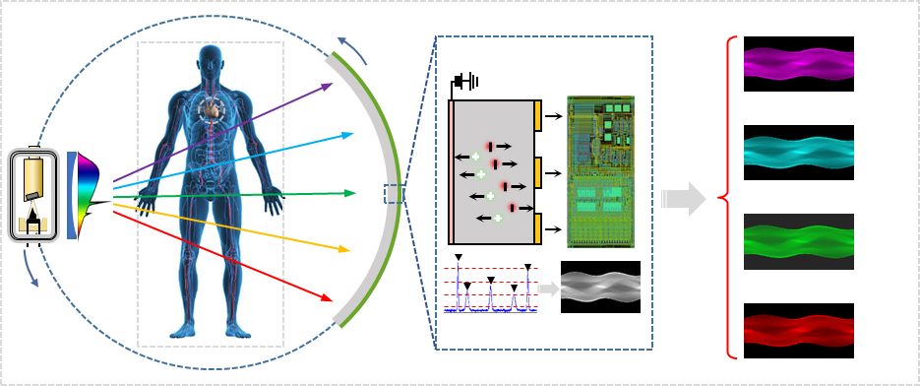
01
Definition and properity of signals
Signals and Systems Abstraction
Photon-counting CT system
The system can be extremely complex! This course will teach you how to analyze it.
Tutorial 1
EE 150
March 2024

Slide 6
01
Definition and properity of signals
1. Classification of signals.
Tutorial 1
EE 150
March 2024

Slide 7
01
Definition and properity of signals
Signal
A function of one or more independent variables.
Will only consider signal function with one variable generally. And that variable is time (t or n).
Tutorial 1
EE 150
March 2024

Slide 8
01
Definition and properity of signals
Signal properties:
Continuous-time or Discrete-time
Even and Odd
Periodic or Aperiodic
Deterministic or Random
Energy and Power signals
Tutorial 1
EE 150
March 2024

Slide 9
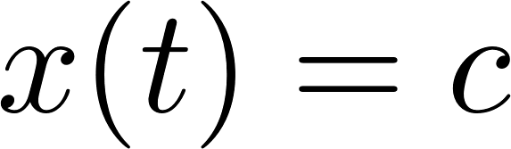
01
Definition and properity of signals
Signal properties: Periodic or Aperiodic
Ex. Determine whether following signals are periodic. If yes, find the fundamental period.
(a)
Tutorial 1
EE 150
March 2024

Slide 10
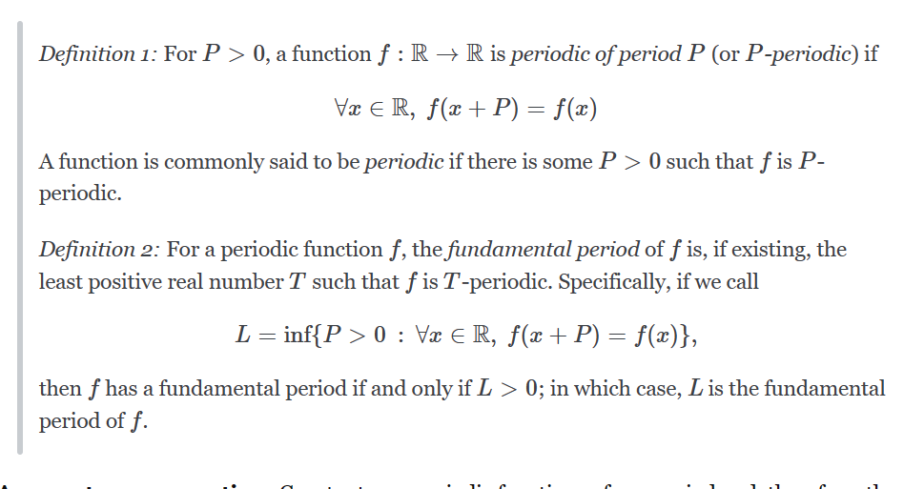
01
Definition and properity of signals
Signal properties: Periodic or Aperiodic
Ex. Determine whether following signals are periodic. If yes, find the fundamental period.
(a)
Periodic but with no fundamental period.
Tutorial 1
EE 150
March 2024

Slide 11
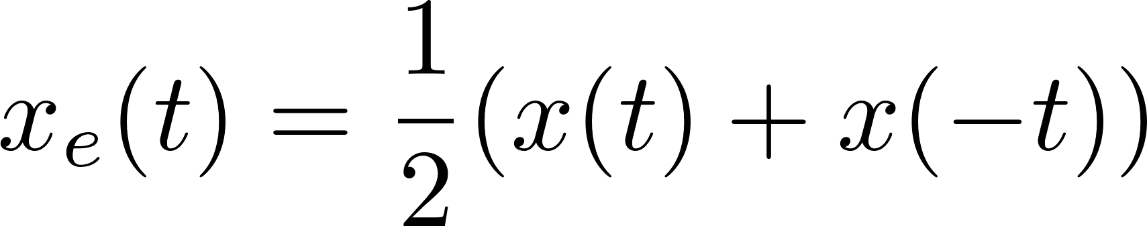
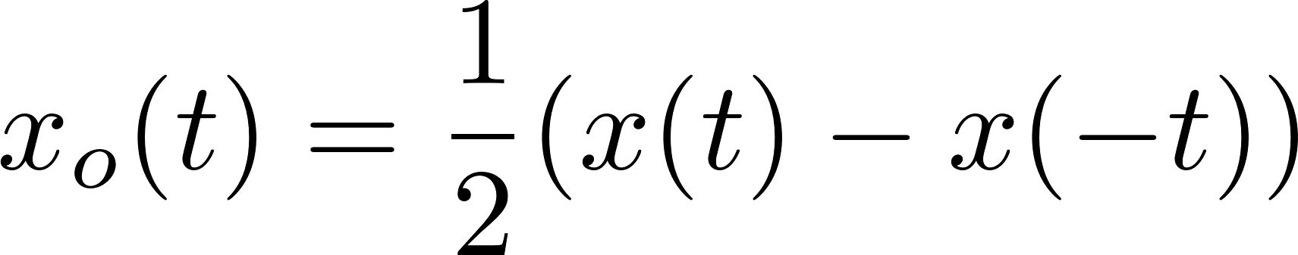
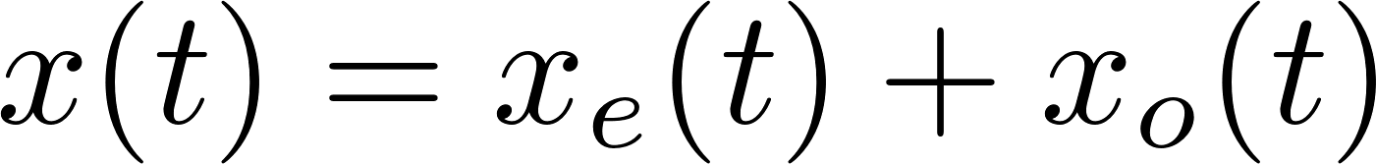
01
Definition and properity of signals
Signal properties: Even and Odd
Tutorial 1
EE 150
March 2024

Slide 12
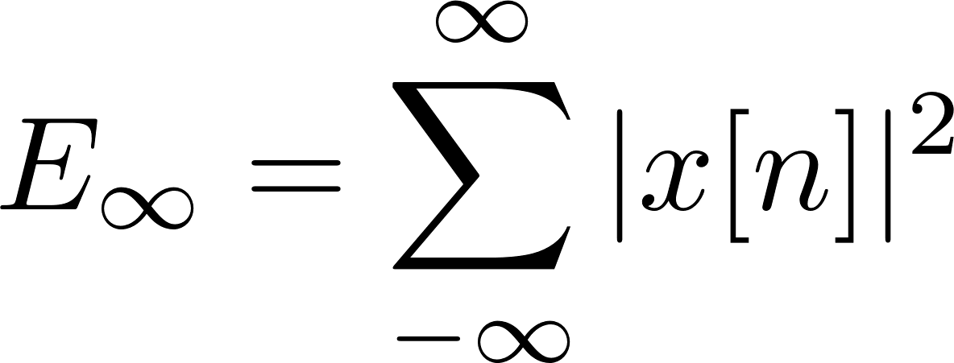
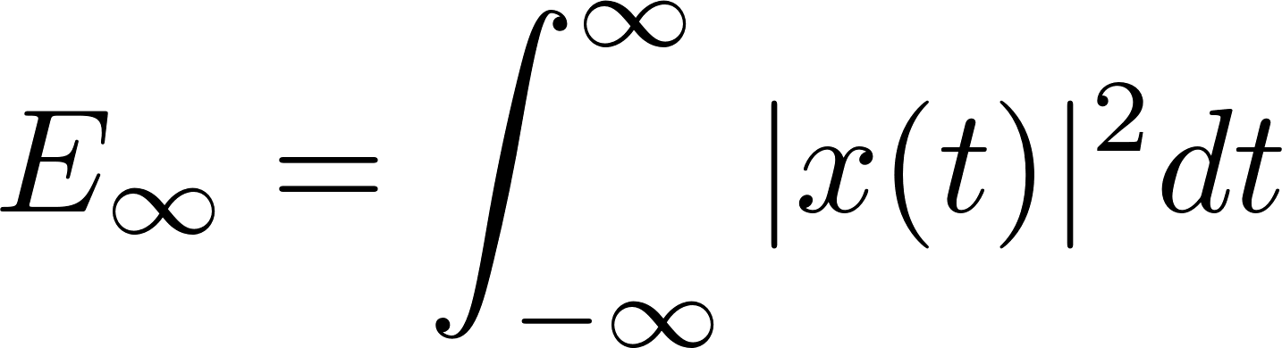
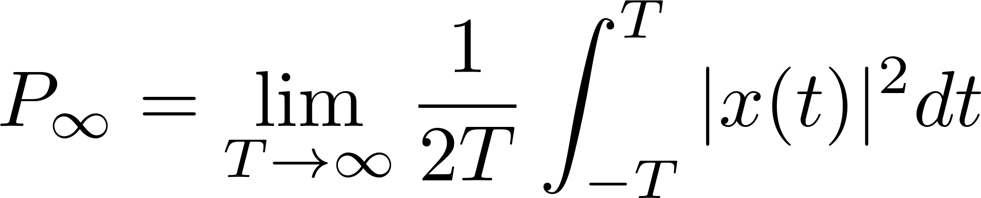
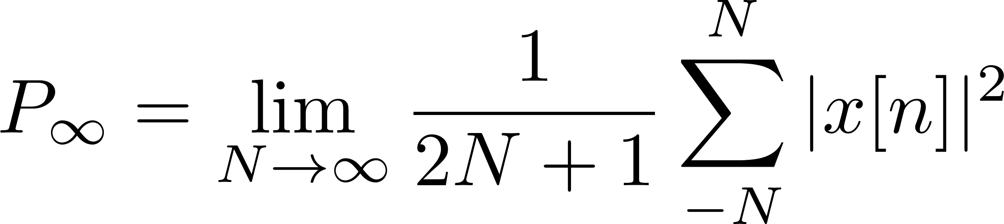
01
Definition and properity of signals
Signal properties: Energy and Power
Finite energy
Finite power
Infinite energy and power
Tutorial 1
EE 150
March 2024

Slide 13
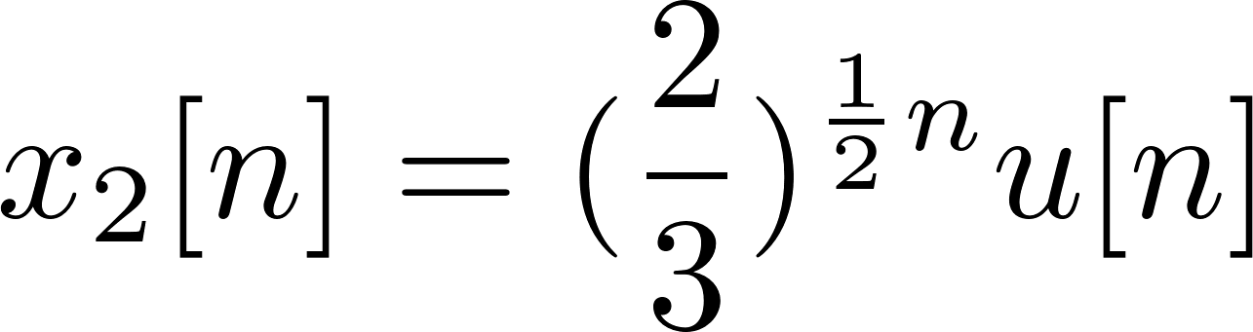
01
Definition and properity of signals
Signal properties: Energy and Power
Calculate the power and energy of following signals.
(a)
Tutorial 1
EE 150
March 2024

Slide 14
02
The operation on signals
2.The operation on signals.
Tutorial 1
EE 150
March 2024

Slide 15
02
The operation on signals
Operations
Transformation in amplitude
Amplitude scaling
Addition
multiplication
Transformation in time scale
Time scaling
Time reversal
Time shifting
Tutorial 1
EE 150
March 2024

Slide 16
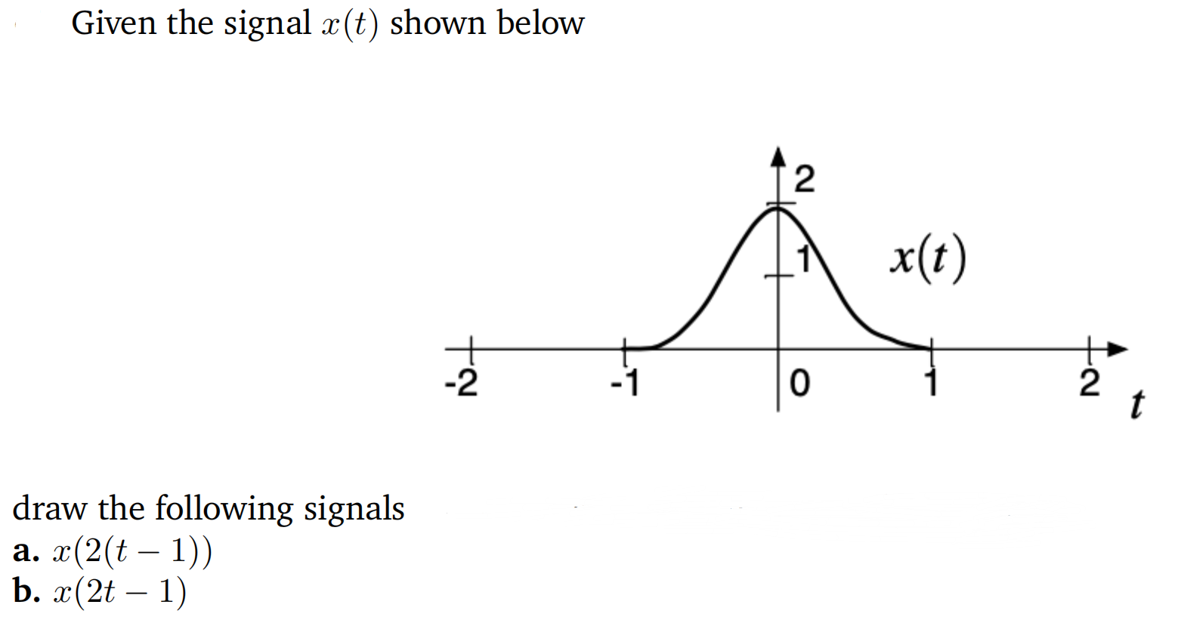
02
The operation on signals
Operations: time shifting
Tutorial 1
EE 150
March 2024

Slide 17
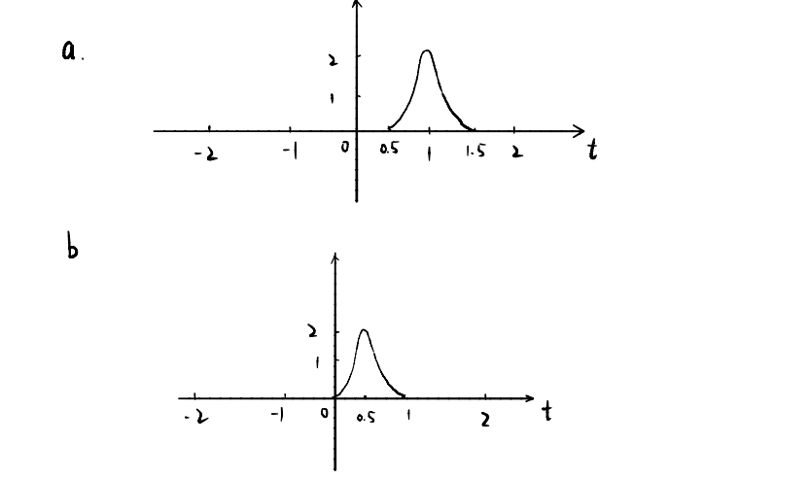
02
The transformation of signals
Tutorial 1
EE 150
March 2024

Slide 18
03
Basic Signals
3.Basic Signals
Tutorial 1
EE 150
March 2024

Slide 19
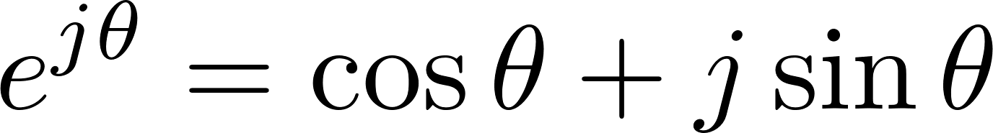
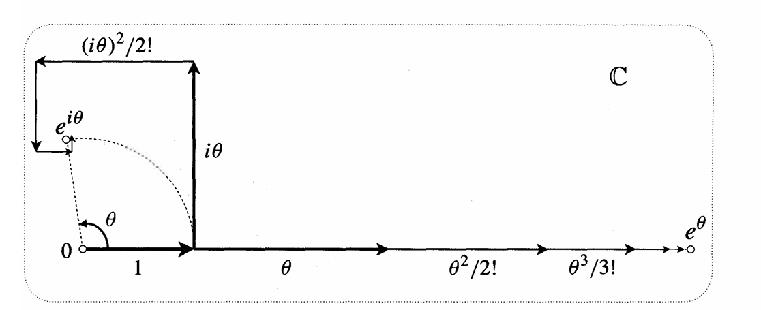
03
Basic Signals
3.Basic Signals
Euler equation:
Power series
Tutorial 1
EE 150
March 2024

Slide 20
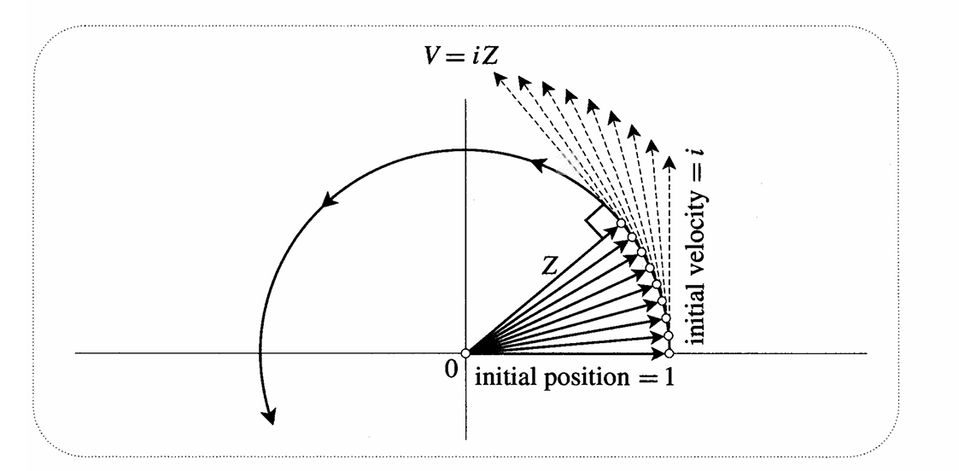
04
Euler Equation
Euler equation: Geometry
Tutorial 1
EE 150
March 2024

Slide 21
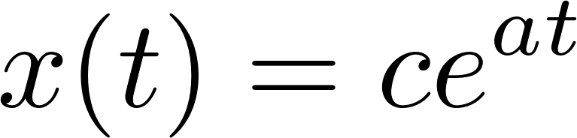
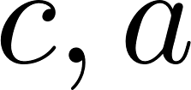
03
Basic Signals
3.Basic Signals
Continuous:
are real
are not real
Fundamental period
Energy and power
Tutorial 1
EE 150
March 2024

Slide 22
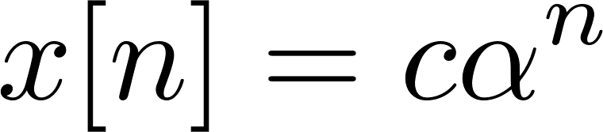
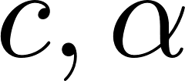
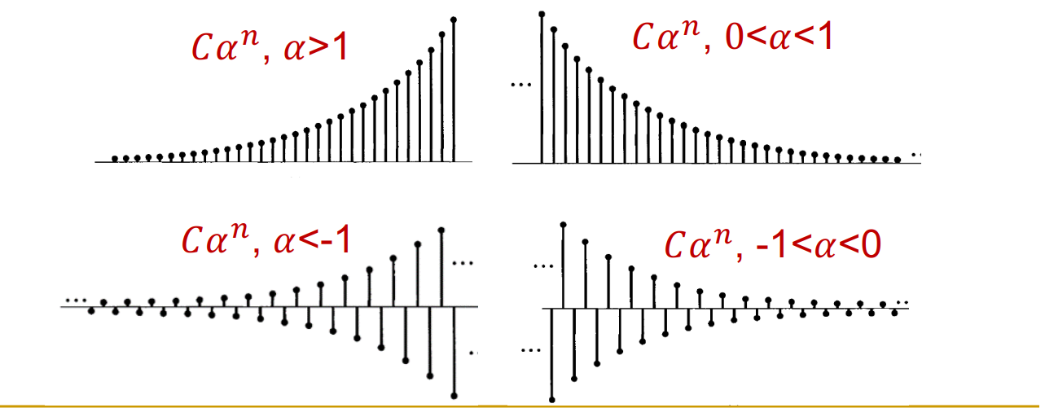
03
Basic Signals
3.Basic Signals
Discrete:
are real
Aperiodic
Energy and power
Tutorial 1
EE 150
March 2024

Slide 23
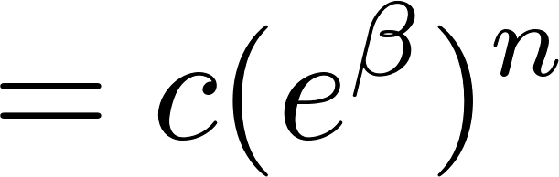
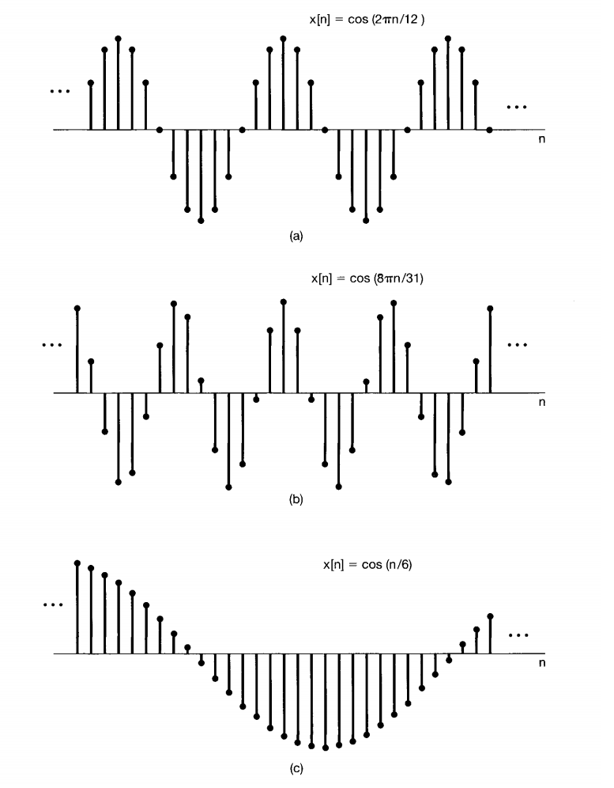


03
Basic Signals
3.Basic Signals
Discrete:
is real and is imaginary
Periodic?
Energy and power
Tutorial 1
EE 150
March 2024

Slide 24
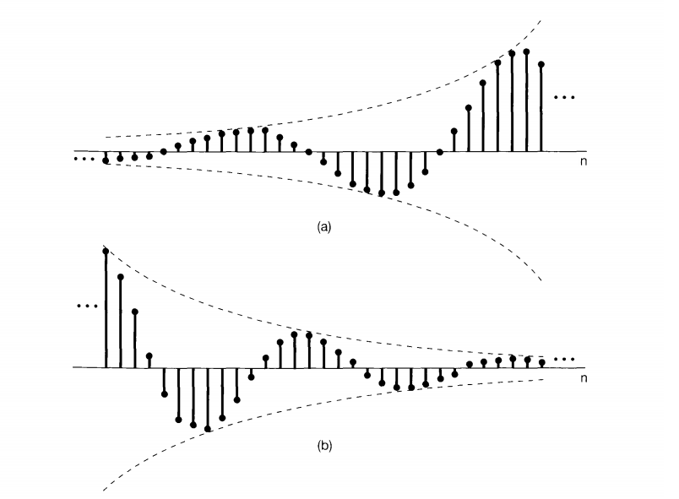
03
Basic Signals
3.Basic Signals
Discrete:
are both complex
Tutorial 1
EE 150
March 2024

Slide 25
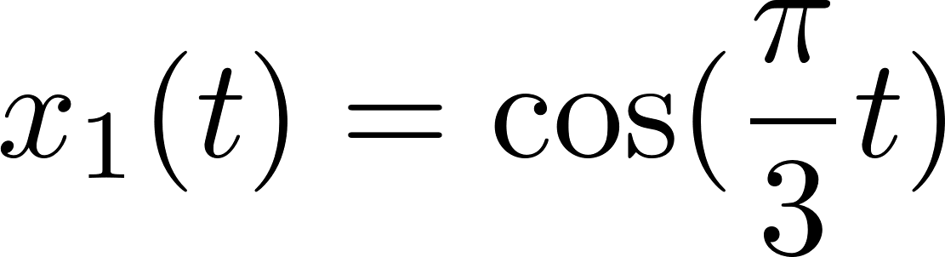
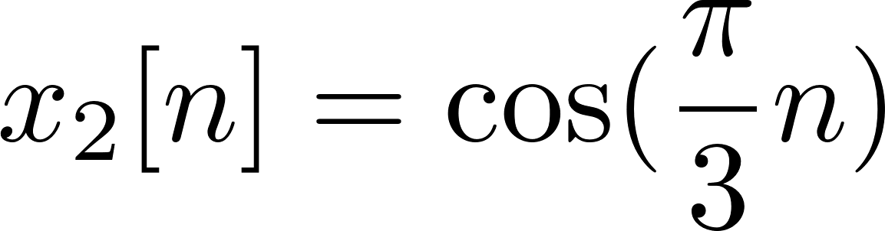
03
Basic Signals
3.Basic Signals: Exercise
Ex Calculate the power and energy of following signals.
(a)
(b)
Tutorial 1
EE 150
March 2024

Slide 26
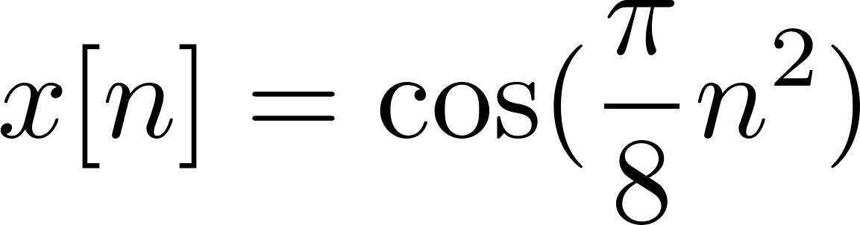
03
Basic Signals
3.Basic Signals: Exercise
Ex. Determine whether following signals are periodic. If yes, find the fundamental period.
(a)
(b)
(c)
Tutorial 1
EE 150
March 2024

Slide 27
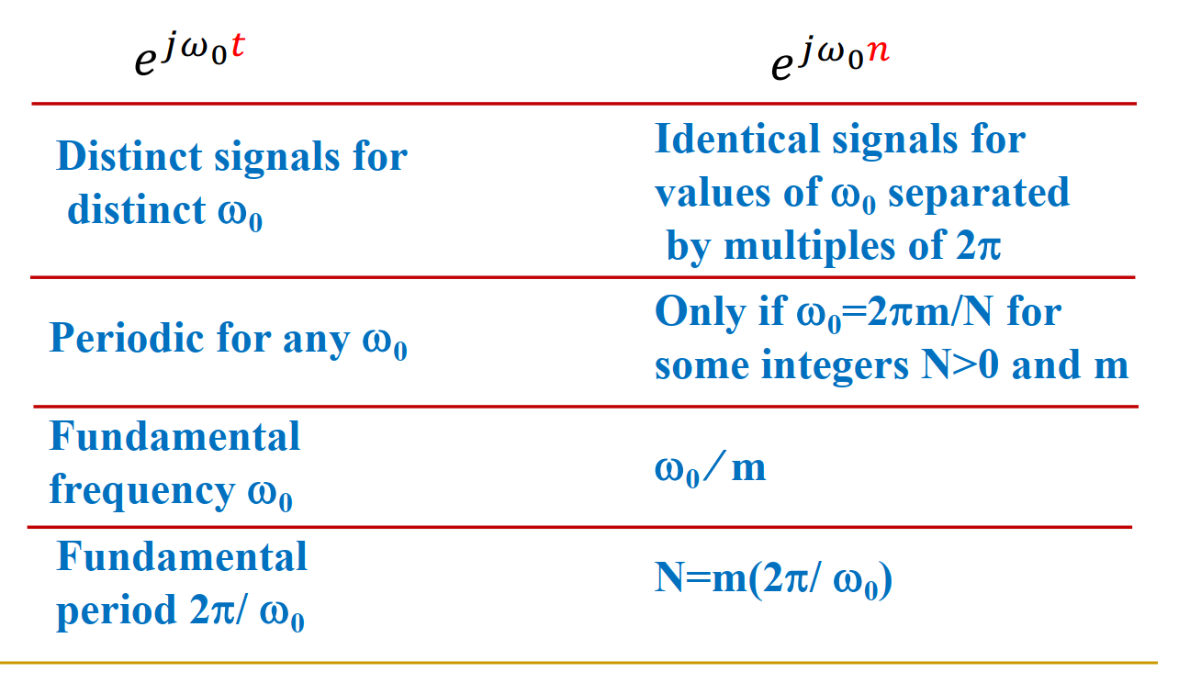
03
Basic Signals
Exponential and Sinusoid Signals
Tutorial 1
EE 150
March 2024

Slide 28
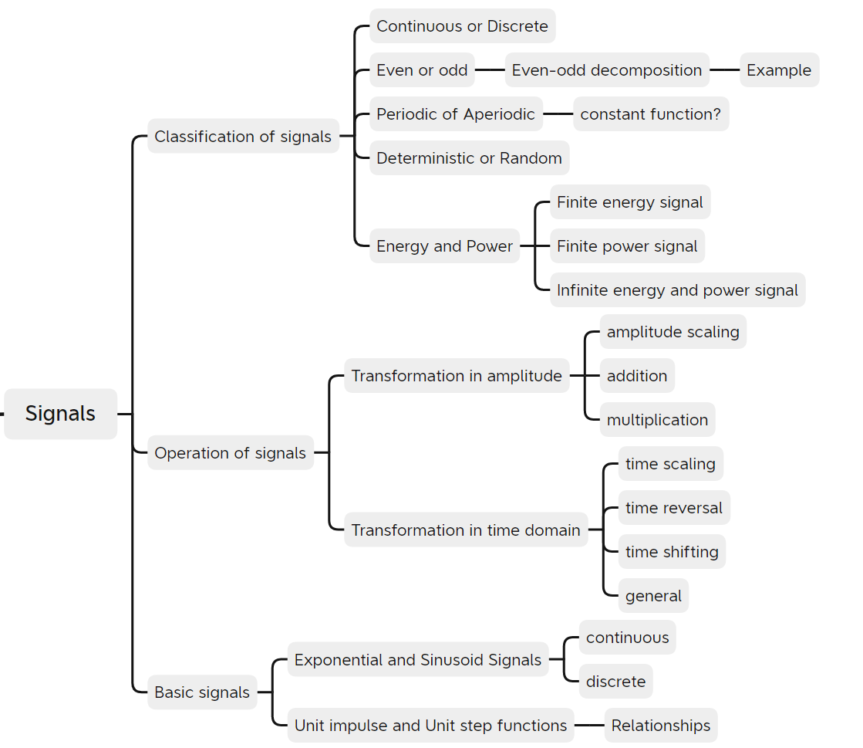
Summary
Summary
Tutorial 1
EE 150
March 2024

